Slide 1
Recidivism
Describe the intent of the data science model behind the Northpointe algorithm?
What data do you think they used for training?
What was the target, the features?
Do you think it is a good idea to use a model like this to help judges and courts determine criminal sentences?
What are the false positives/negatives in this predictive model? What are the costs of each? How would you consider going about setting a threshold?
They did not use race in their model, so why do you think the results are so different for race?
How do you think they could have gotten around this?
See confusion matrix and calculate accuracy, precision and recall for Black Defendants and for White Defendants. Do your answers agree with the article?
Notes:
Education and employment
Using traits like intelligence, introversion and extroversion for to build assessment scores.
The problem is that the score is solely being used, instead of being taken into account with other factors.

Slide 2
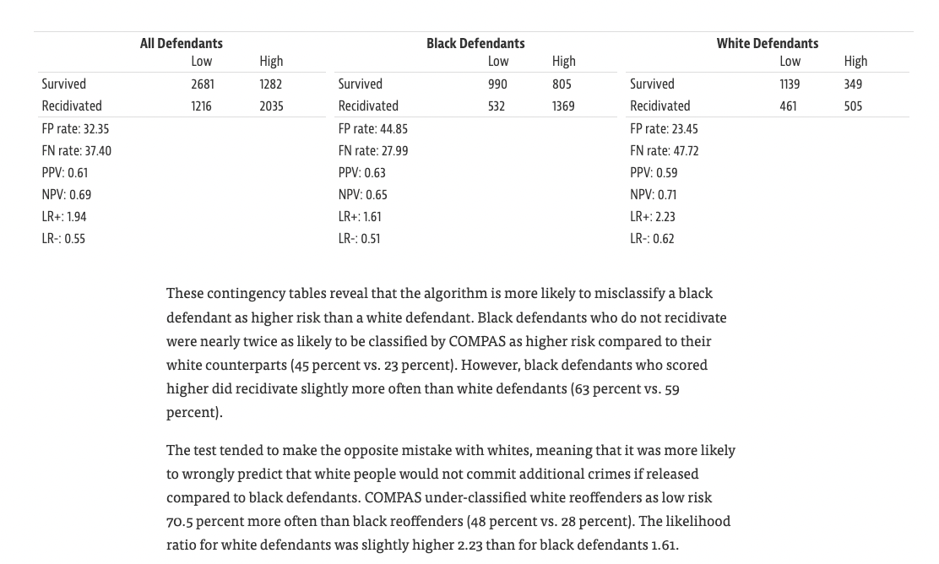
https://en.wikipedia.org/wiki/Confusion_matrix
Notes:
Precision measures FP related to TP
FPR measures FP related to TN
For those that truly did not re-offend, blacks were more likely to be predicted as offenders

